Slide 1
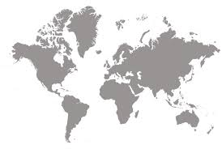
COUNTRY DATA CLUSTERING
Peer RevieW
Seán Coffey, September 2025
GitHub: https://github.com/sean-coffey/5510_final_project

Slide 2
Cluster Countries based on socio-Economic features to support decision making About Focus of AID
Learning Objectives - PRIMARY:
Investigate how to understand and interpret Principal Components
Investigate K-Means optimization, visualization and understanding
Compare K-Means with other methods (e.g. DBSCAN, Hiearchical)
Task Objectives from Kaggle - SECONDARY
Categorise countries using socio-economic and health factors that determine the overall development of the country.
Suggest the countries which the CEO of HELP organisation needs to focus on the most.

Slide 3
Country DATA From Kaggle
Feature | Description
country | Name of the country
child_mort | Death of children under 5 years of age per 1000 live births
exports | Exports of goods and services per capita. Given as %age of the GDP per capita
health | Total health spending per capita. Given as %age of GDP per capita
imports | Imports of goods and services per capita. Given as %age of the GDP per capita
Income | Net income per person
Inflation | The measurement of the annual growth rate of the Total GDP
life_expec | The average number of years a new born child would live if the current mortality patterns are to remain the same
total_fer | The number of children that would be born to each woman if the current age-fertility rates remain the same.
gdpp | The GDP per capita. Calculated as the Total GDP divided by the total population.
Size and characteristics
167 Countries
9 socio-economic features
All numeric
No missing values
Very different scales
Significant Outliers
Some correlations
https://www.kaggle.com/datasets/rohan0301/unsupervised-learning-on-country-data

Slide 4
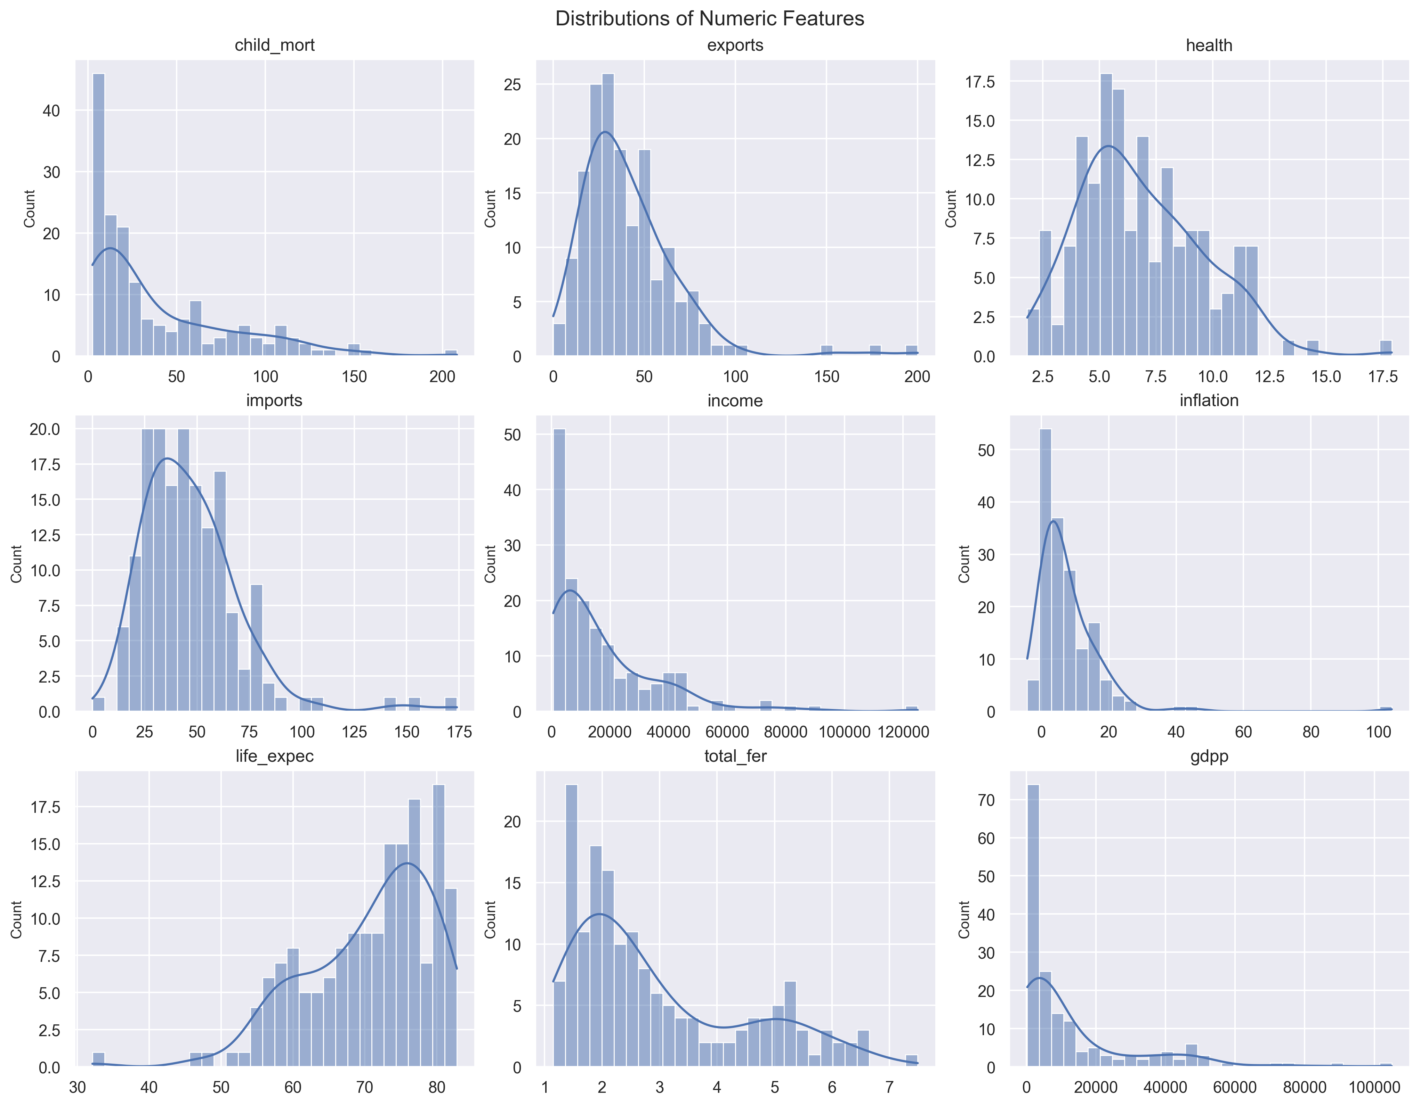
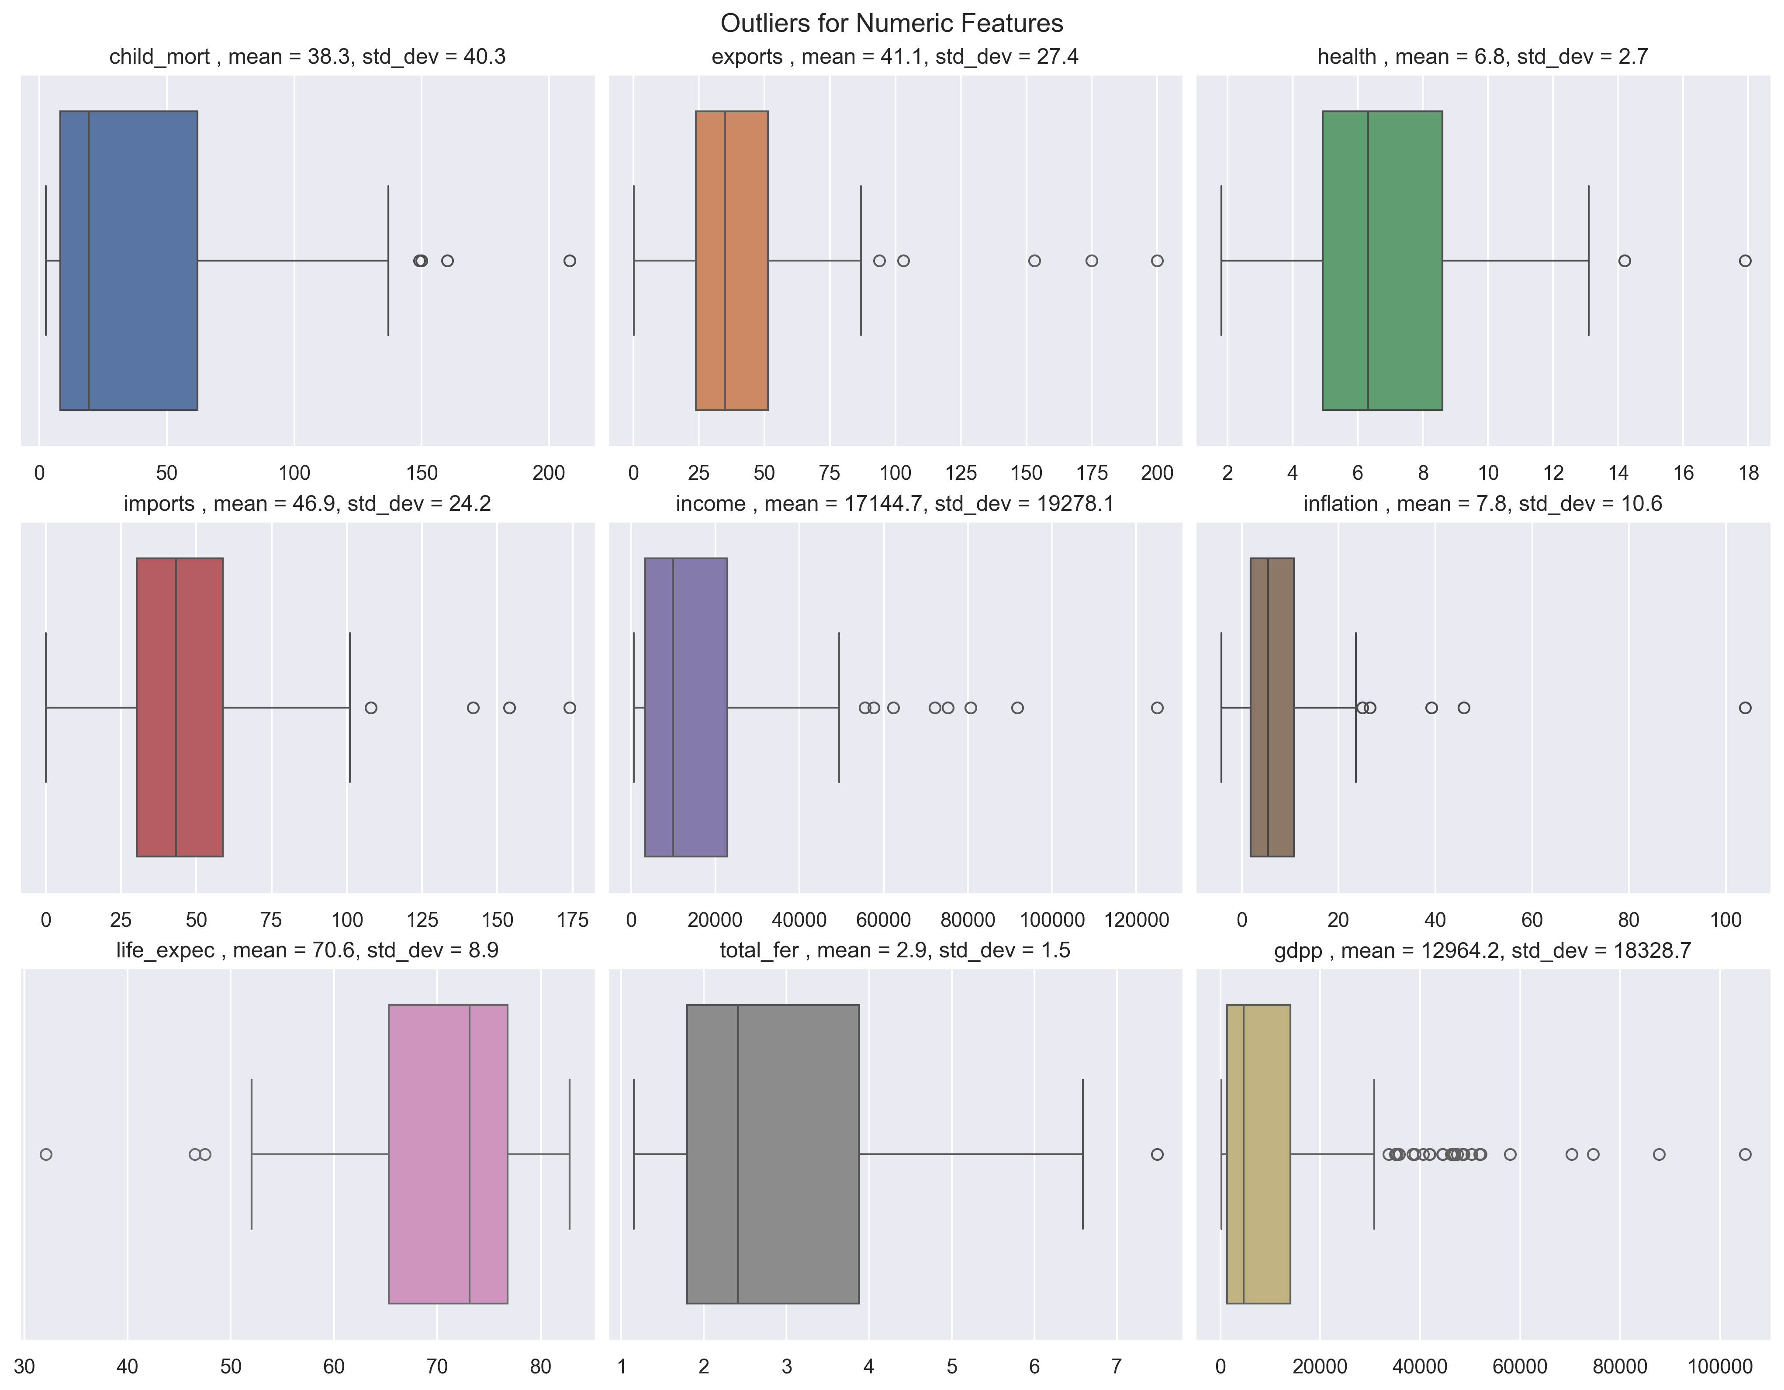
EDA Revealed features that need log scaling and outliers that need treatment
Notes:
Most informative features visually:
Oldpeak (higher values strongly linked to higher num severity).
Thalch (lower heart rate at peak exercise associated with more severe heart disease).
Age + Thalch together show meaningful separation — younger, fitter patients are often in num=0.
Least informative features visually:
Trestbps and Chol show significant overlap across classes — likely weaker predictors.
Takeaway / Modeling Implications
Decision to focus on Cleveland dataset makes sense — others have very small counts and slightly different distributions, which could introduce dataset shift.
Class imbalance handling will be important (e.g., stratified sampling, class weights).
Key categorical predictors likely to be: cp, ca, thal, slope.

Slide 5
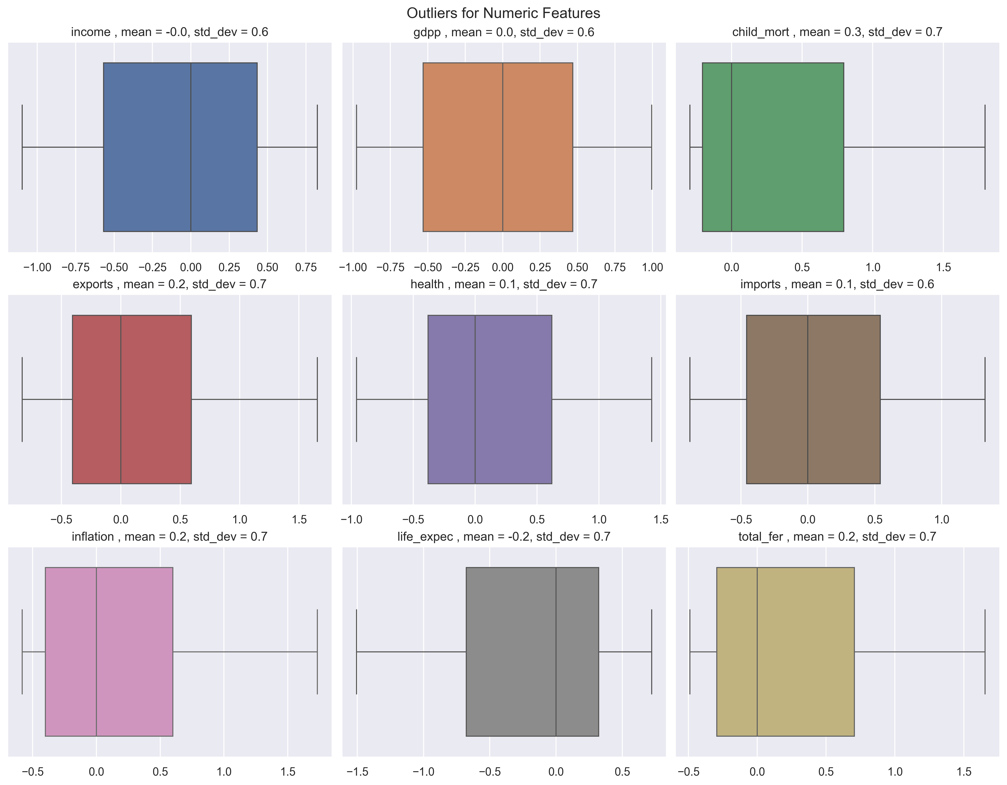
Data Scaling and Outlier Treatment
Log Transform
Income
gdpp
Winsorization to cap outliers
5th percentile lower bound
95th percentile upper bound
RobustScaler
based on median and IQR
Kept a version B without Winsorization
https://www.kaggle.com/datasets/rohan0301/unsupervised-learning-on-country-data

Slide 6
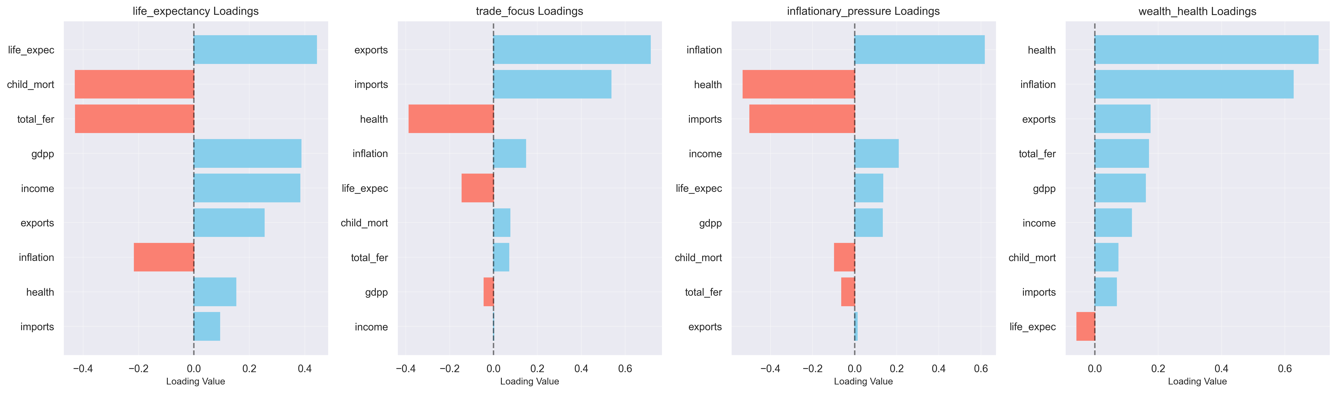
Principal ComPonEnT Analysis with Meaningful Naming based on Loadings
Life Expectancy
Trade Focus
Inflationary Pressure
Wealth Health
52% of Variance
17% of Variance
15% of Variance
7% of Variance

Slide 7
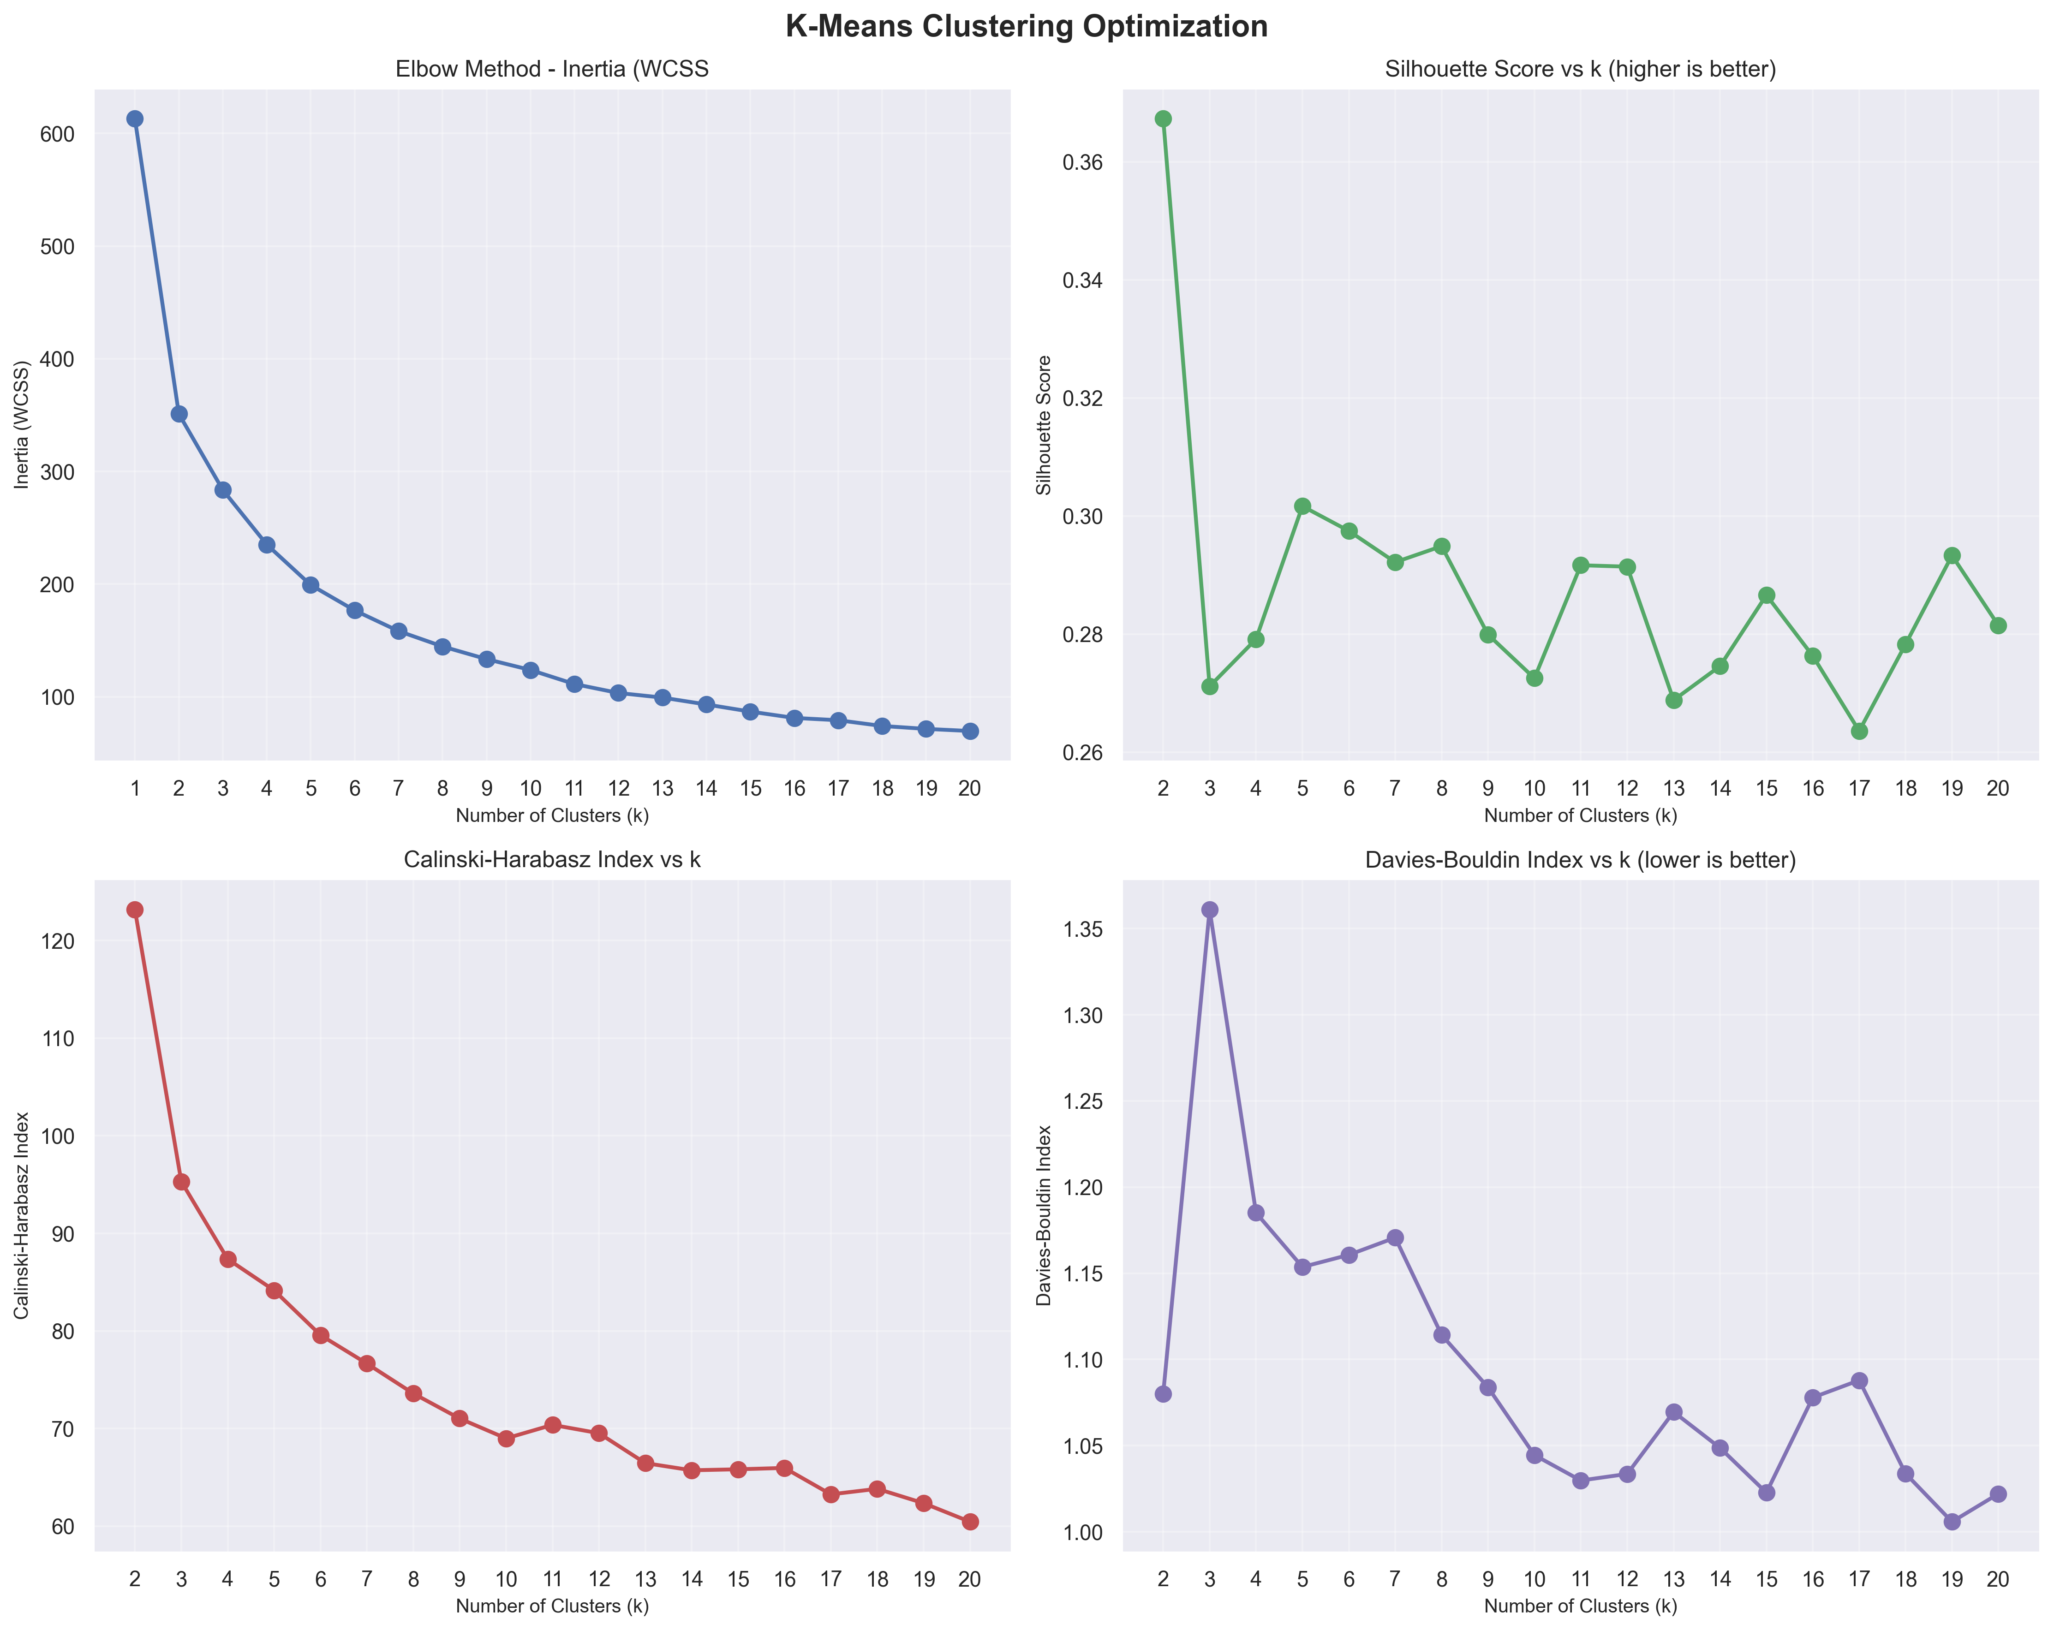
Optimising the number of clusters based on scoring methods – finally selecting 5 to optimize insight
Elbow Method based on WCSS
Silhouette Scoring (similarity)
Calinksi-Harabasz Index (dispersion)
Davies Bouldin Index (next most similar)
Scores alone suggests k = 2
To get more insight set k = 5
Next best scores on metrics (after 2)

Slide 8
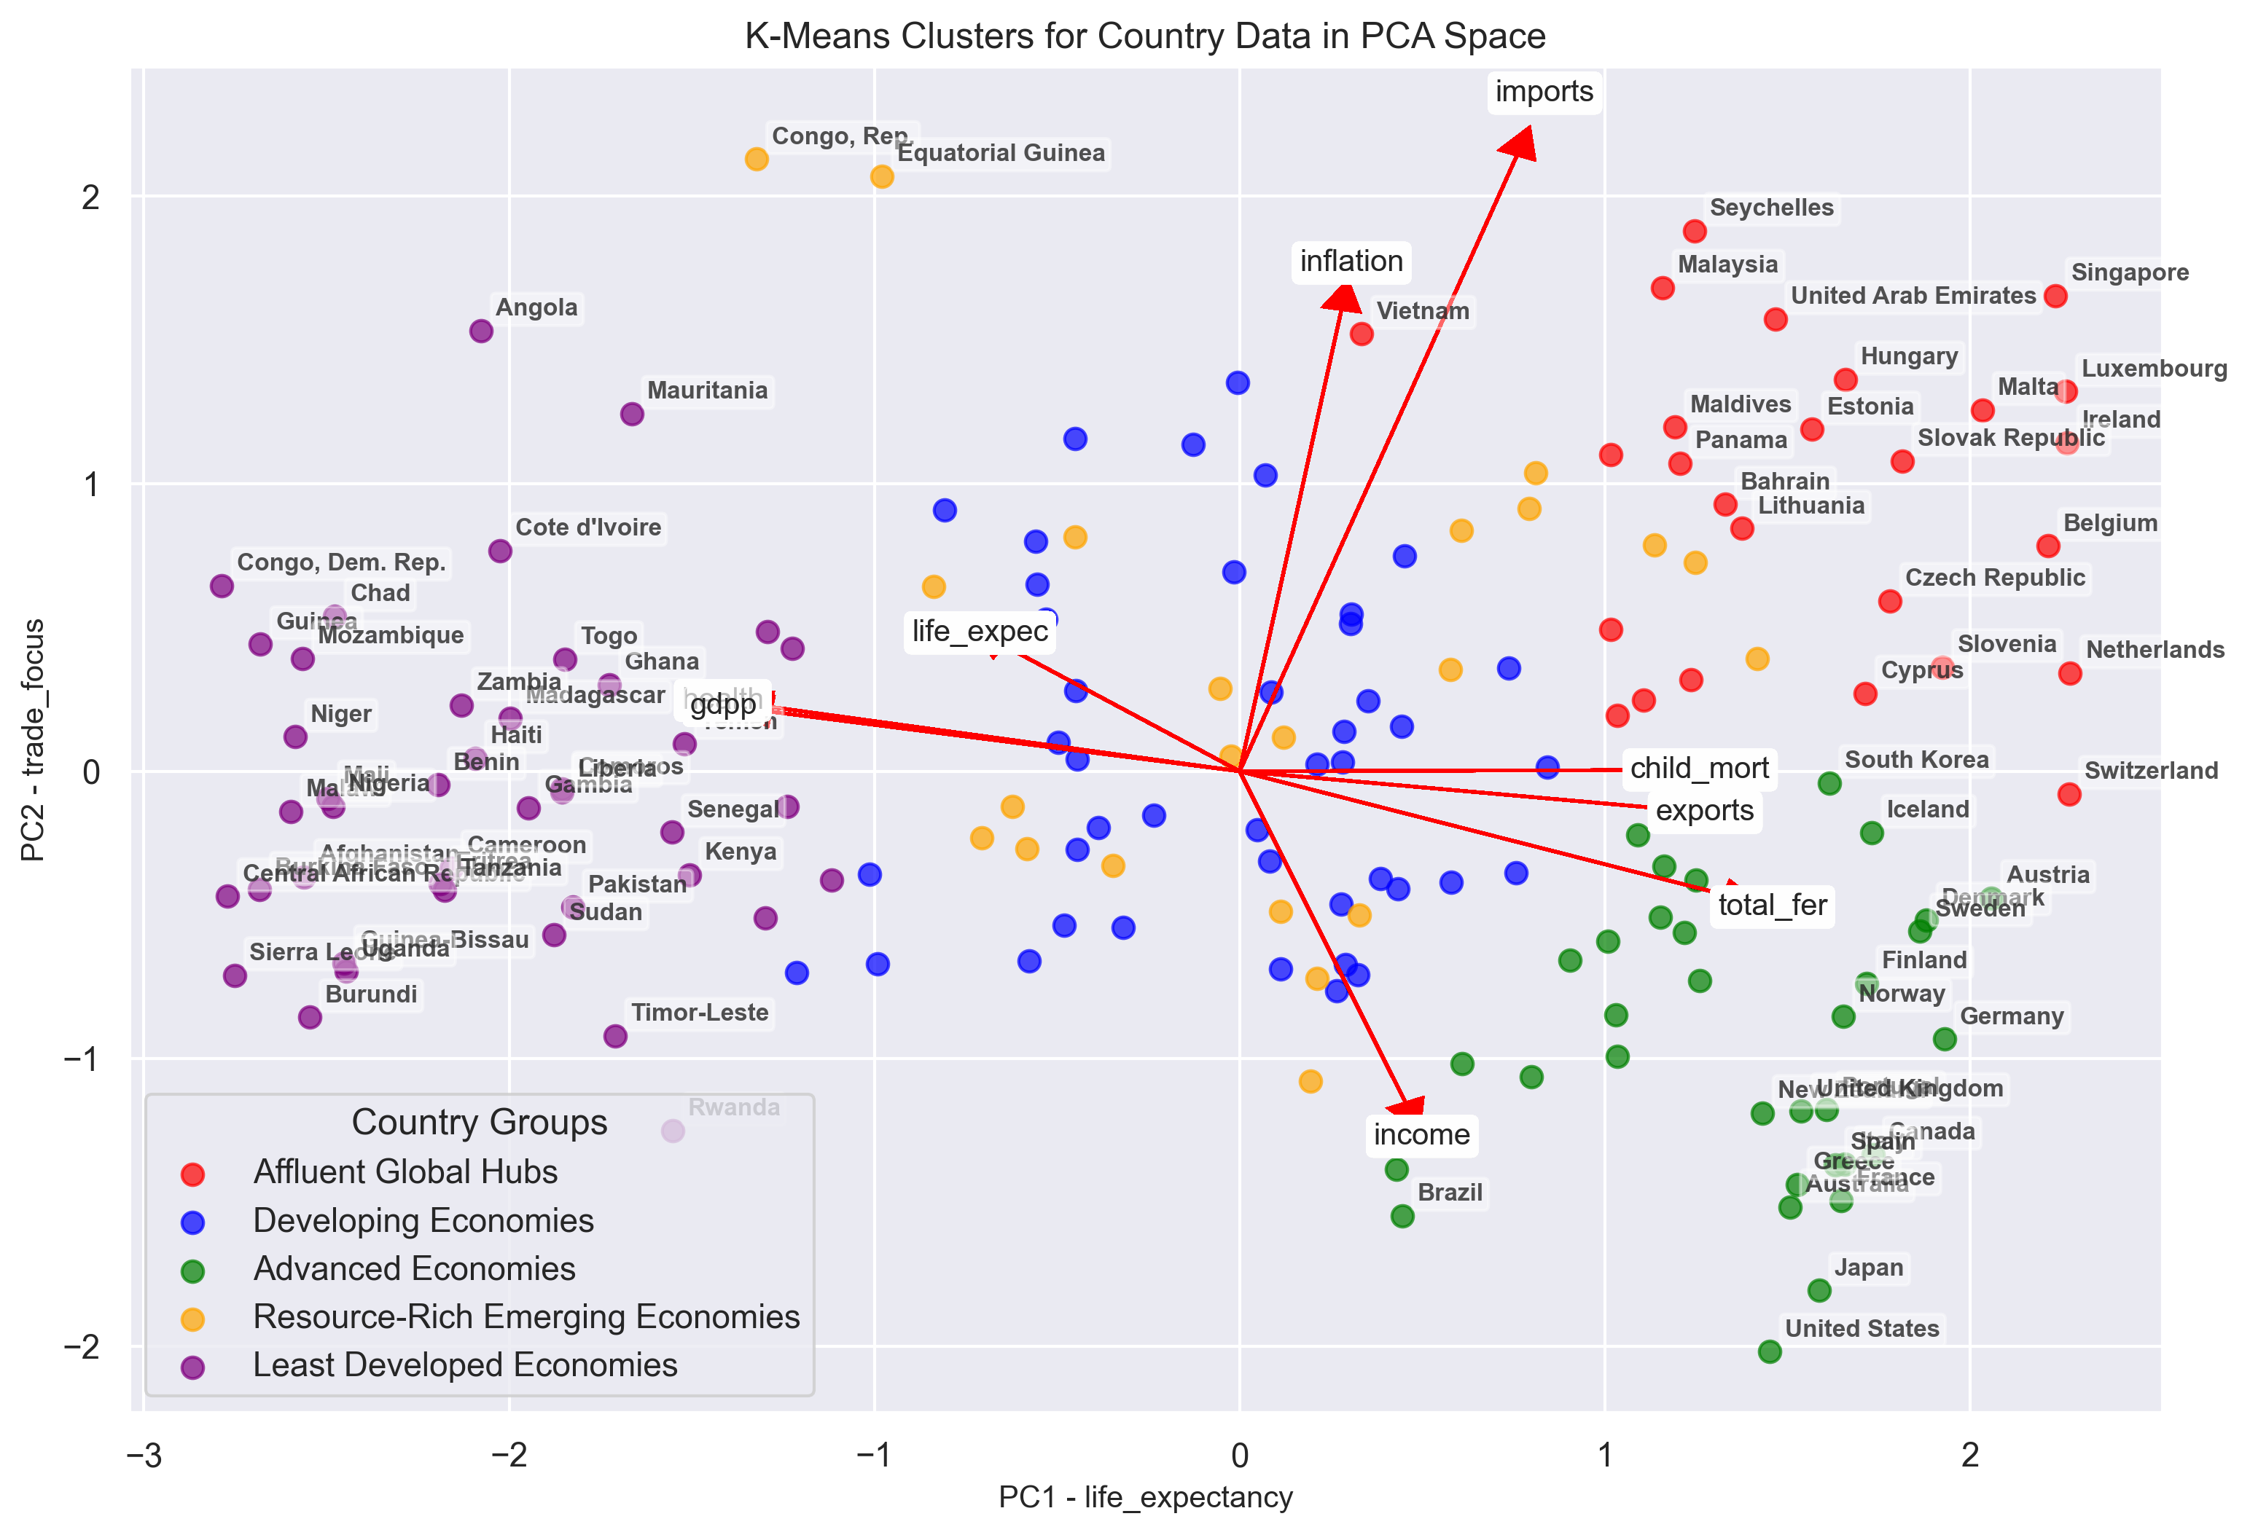

Slide 9
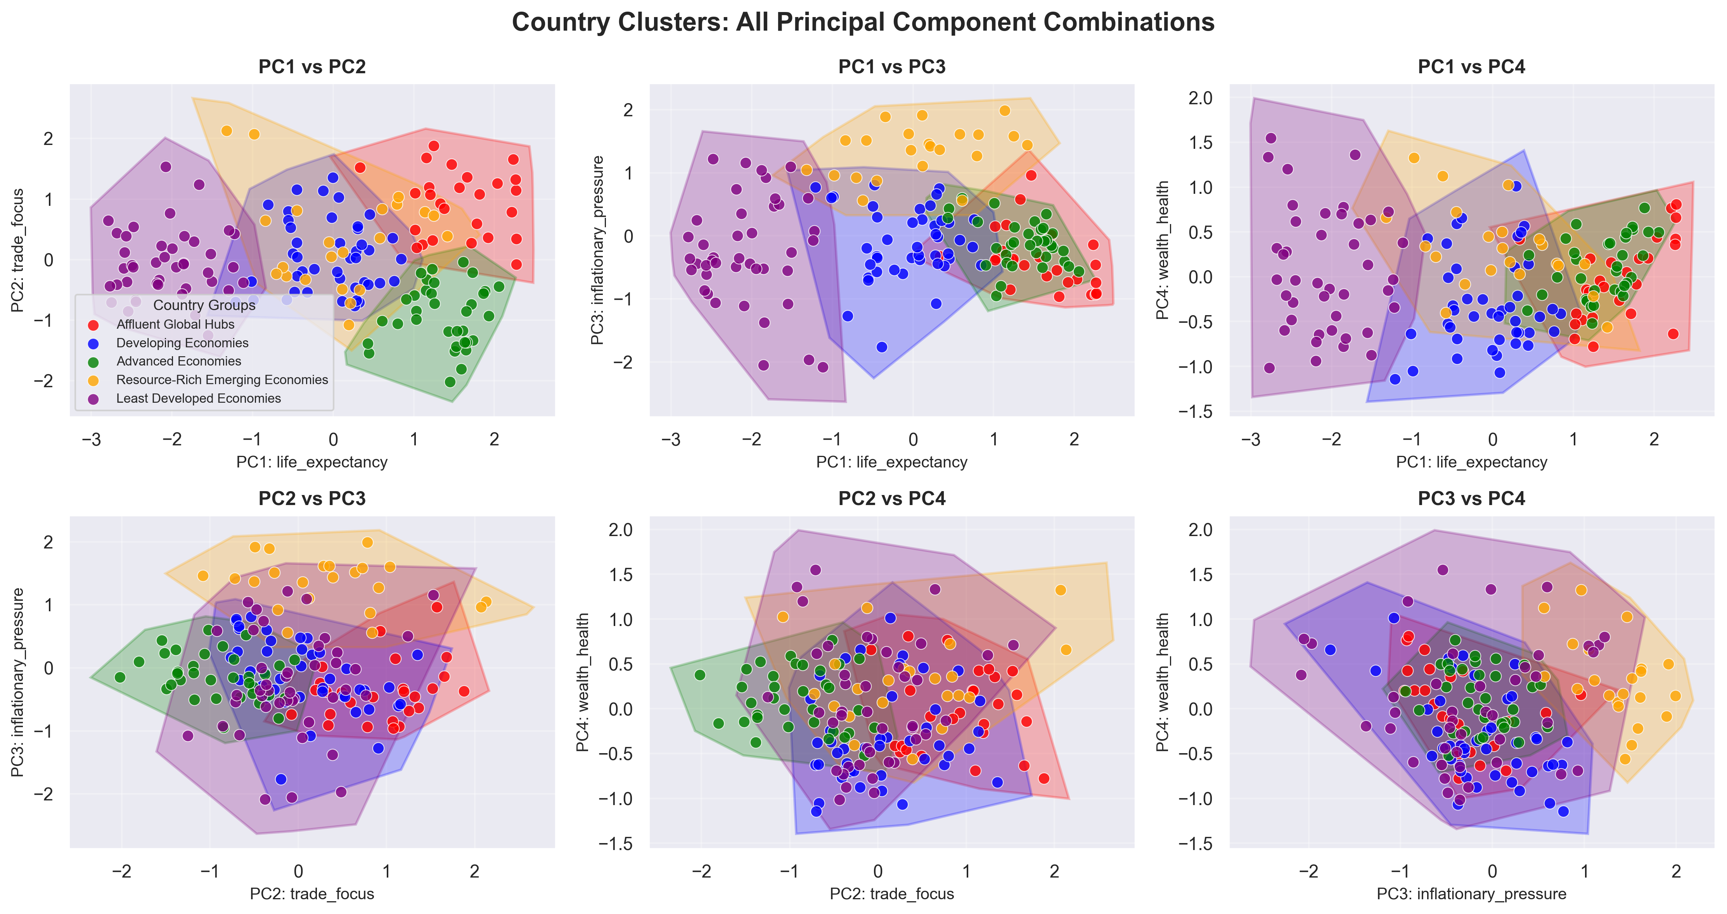
Looking at ALL POSSIBLE Principal Component Combinations to improve UNDERSTANDING

Slide 10
ResuLTING CLuSTERS AFTER ANALYSIS
Cluster 4 → “Least Developed Countries” Lowest income, lowest life expectancy, highest child mortality. Facing structural poverty and health challenges. Examples: Angola, Nigeria, Yemen. | Cluster 3 → “Resource-Rich Emerging States” High average incomes but weaker social indicators (higher child mortality, lower health spending). Reliant on natural resources (oil/gas wealth) and subject to high-inflation Examples: Qatar, Kuwait, Brunei. | Cluster 0 → “Affluent Global Hubs” Very high income, globally integrated (imports/exports heavy). Strong health outcomes, high life expectancy. Examples: Luxembourg, Singapore, UAE.
 | Cluster 1 → “Developing Economies” Lower-middle income, moderate life expectancy, Improving but uneven health/development outcomes. Examples: Romania, Botswana, Bangladesh. | Cluster 2 → “Advanced Economies” Classic developed nations with high GDP, high health spending, long life expectancy. Examples: US, Norway, Denmark.
AID FOCUS
PC2 – Trade Focus
PC1 – Life Expectancy (increasing life expectancy and increasing wealth)

Slide 11
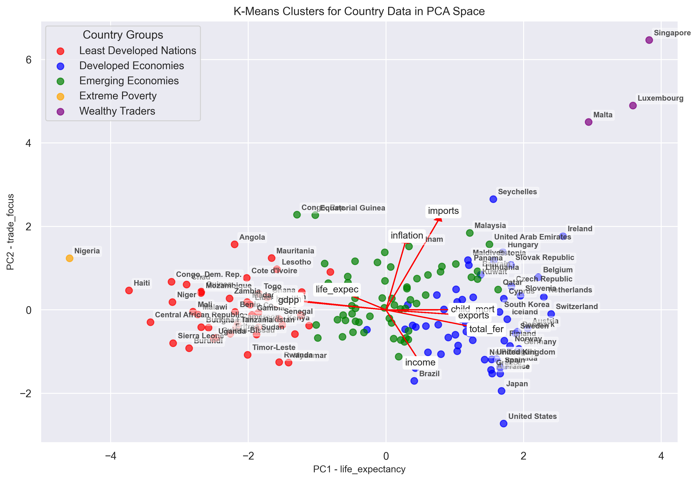
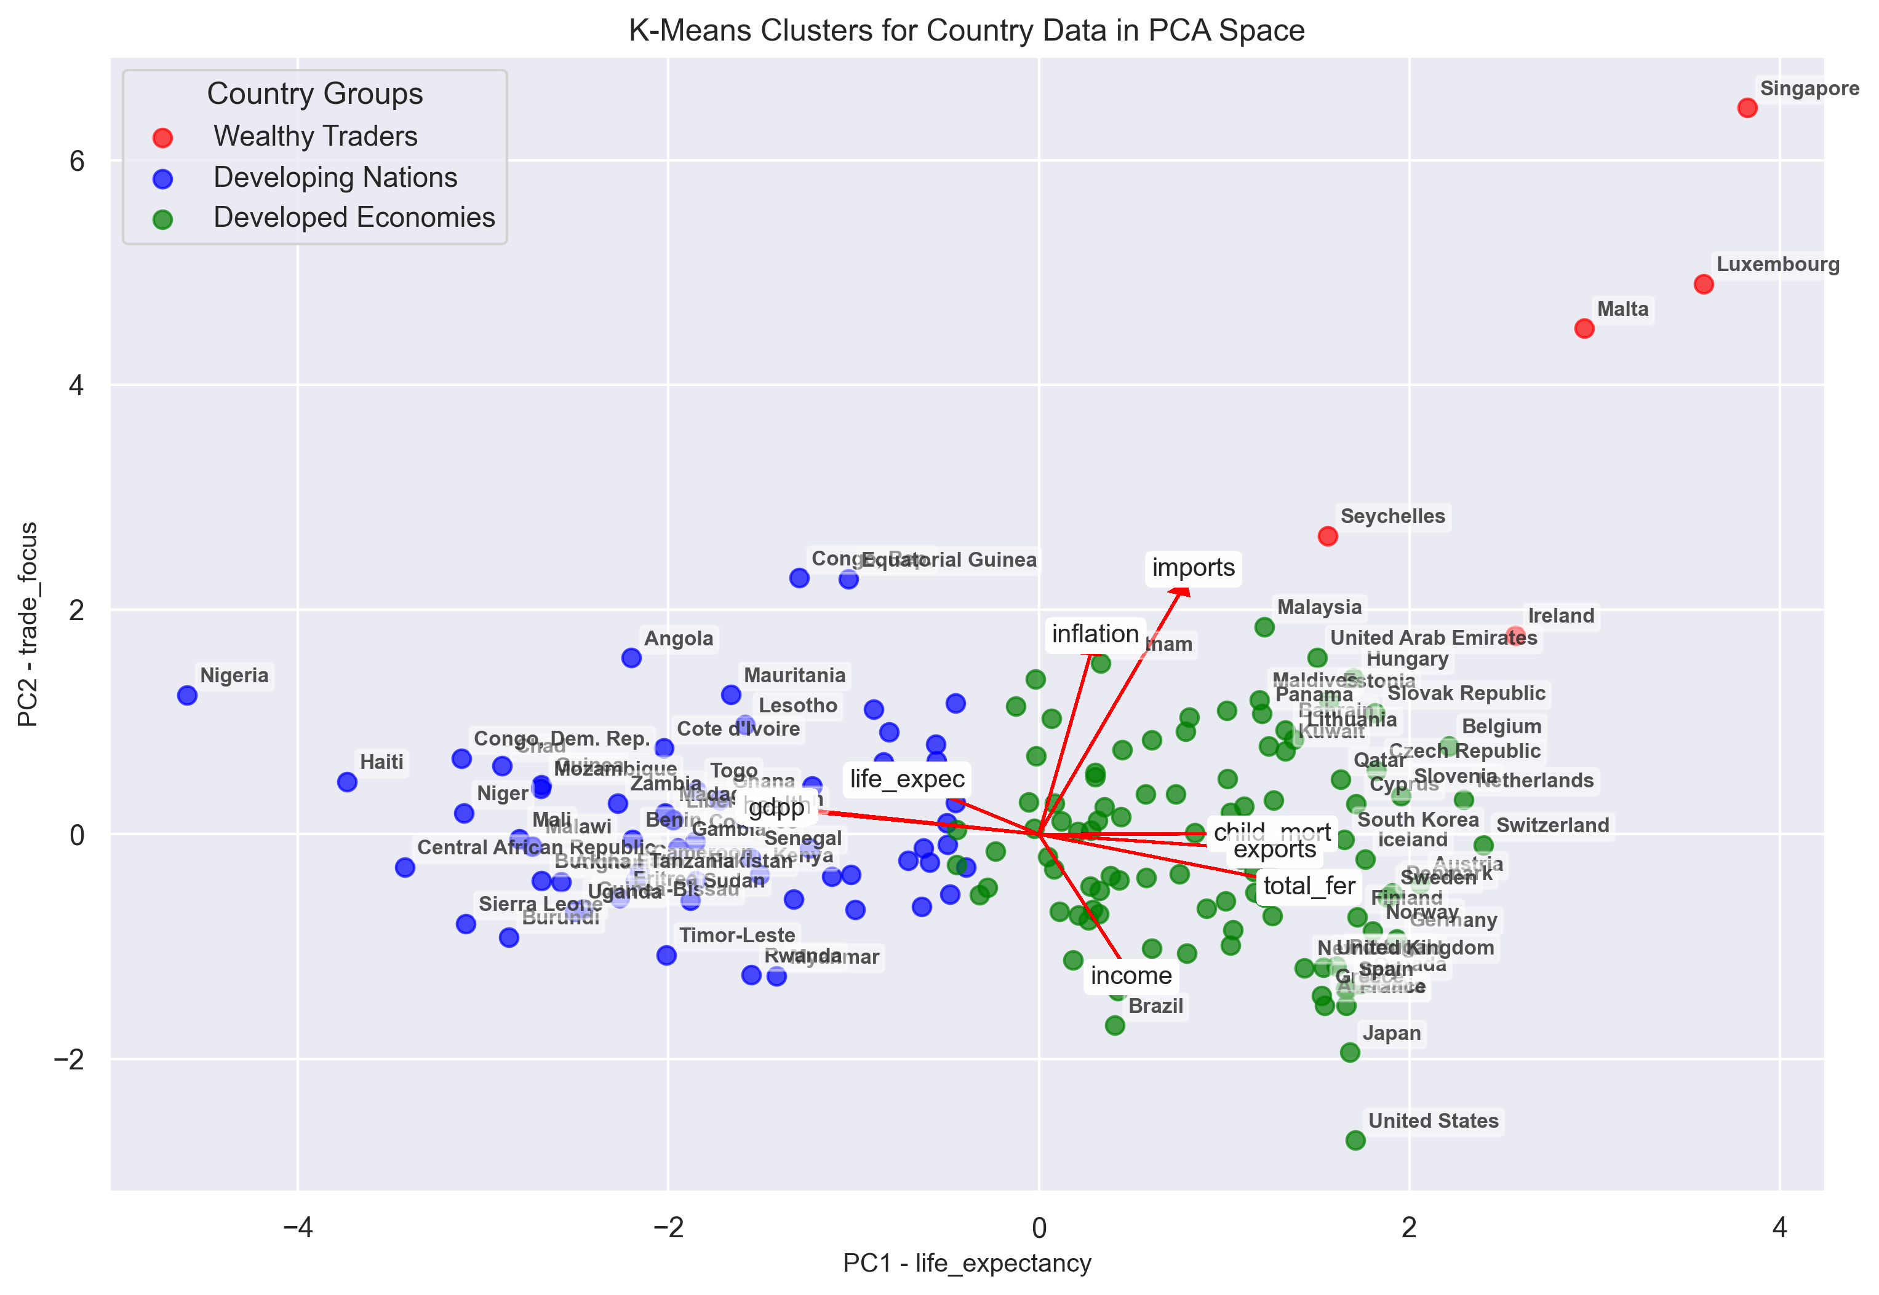
COMPARISON WITHOUT WINSORIZATION – OUTLIERS DOMINATE
Five Cluster Solution with Outliers
Three Cluster Solution for Comparison

Slide 12
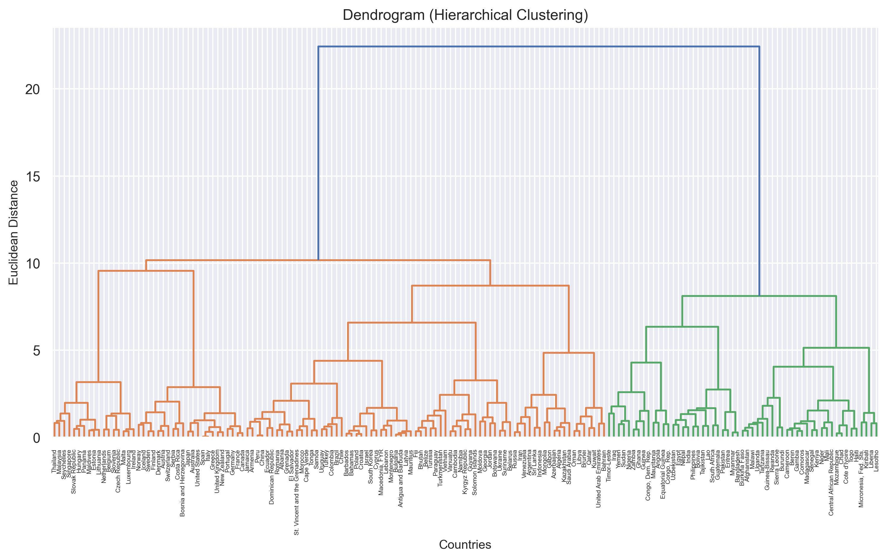
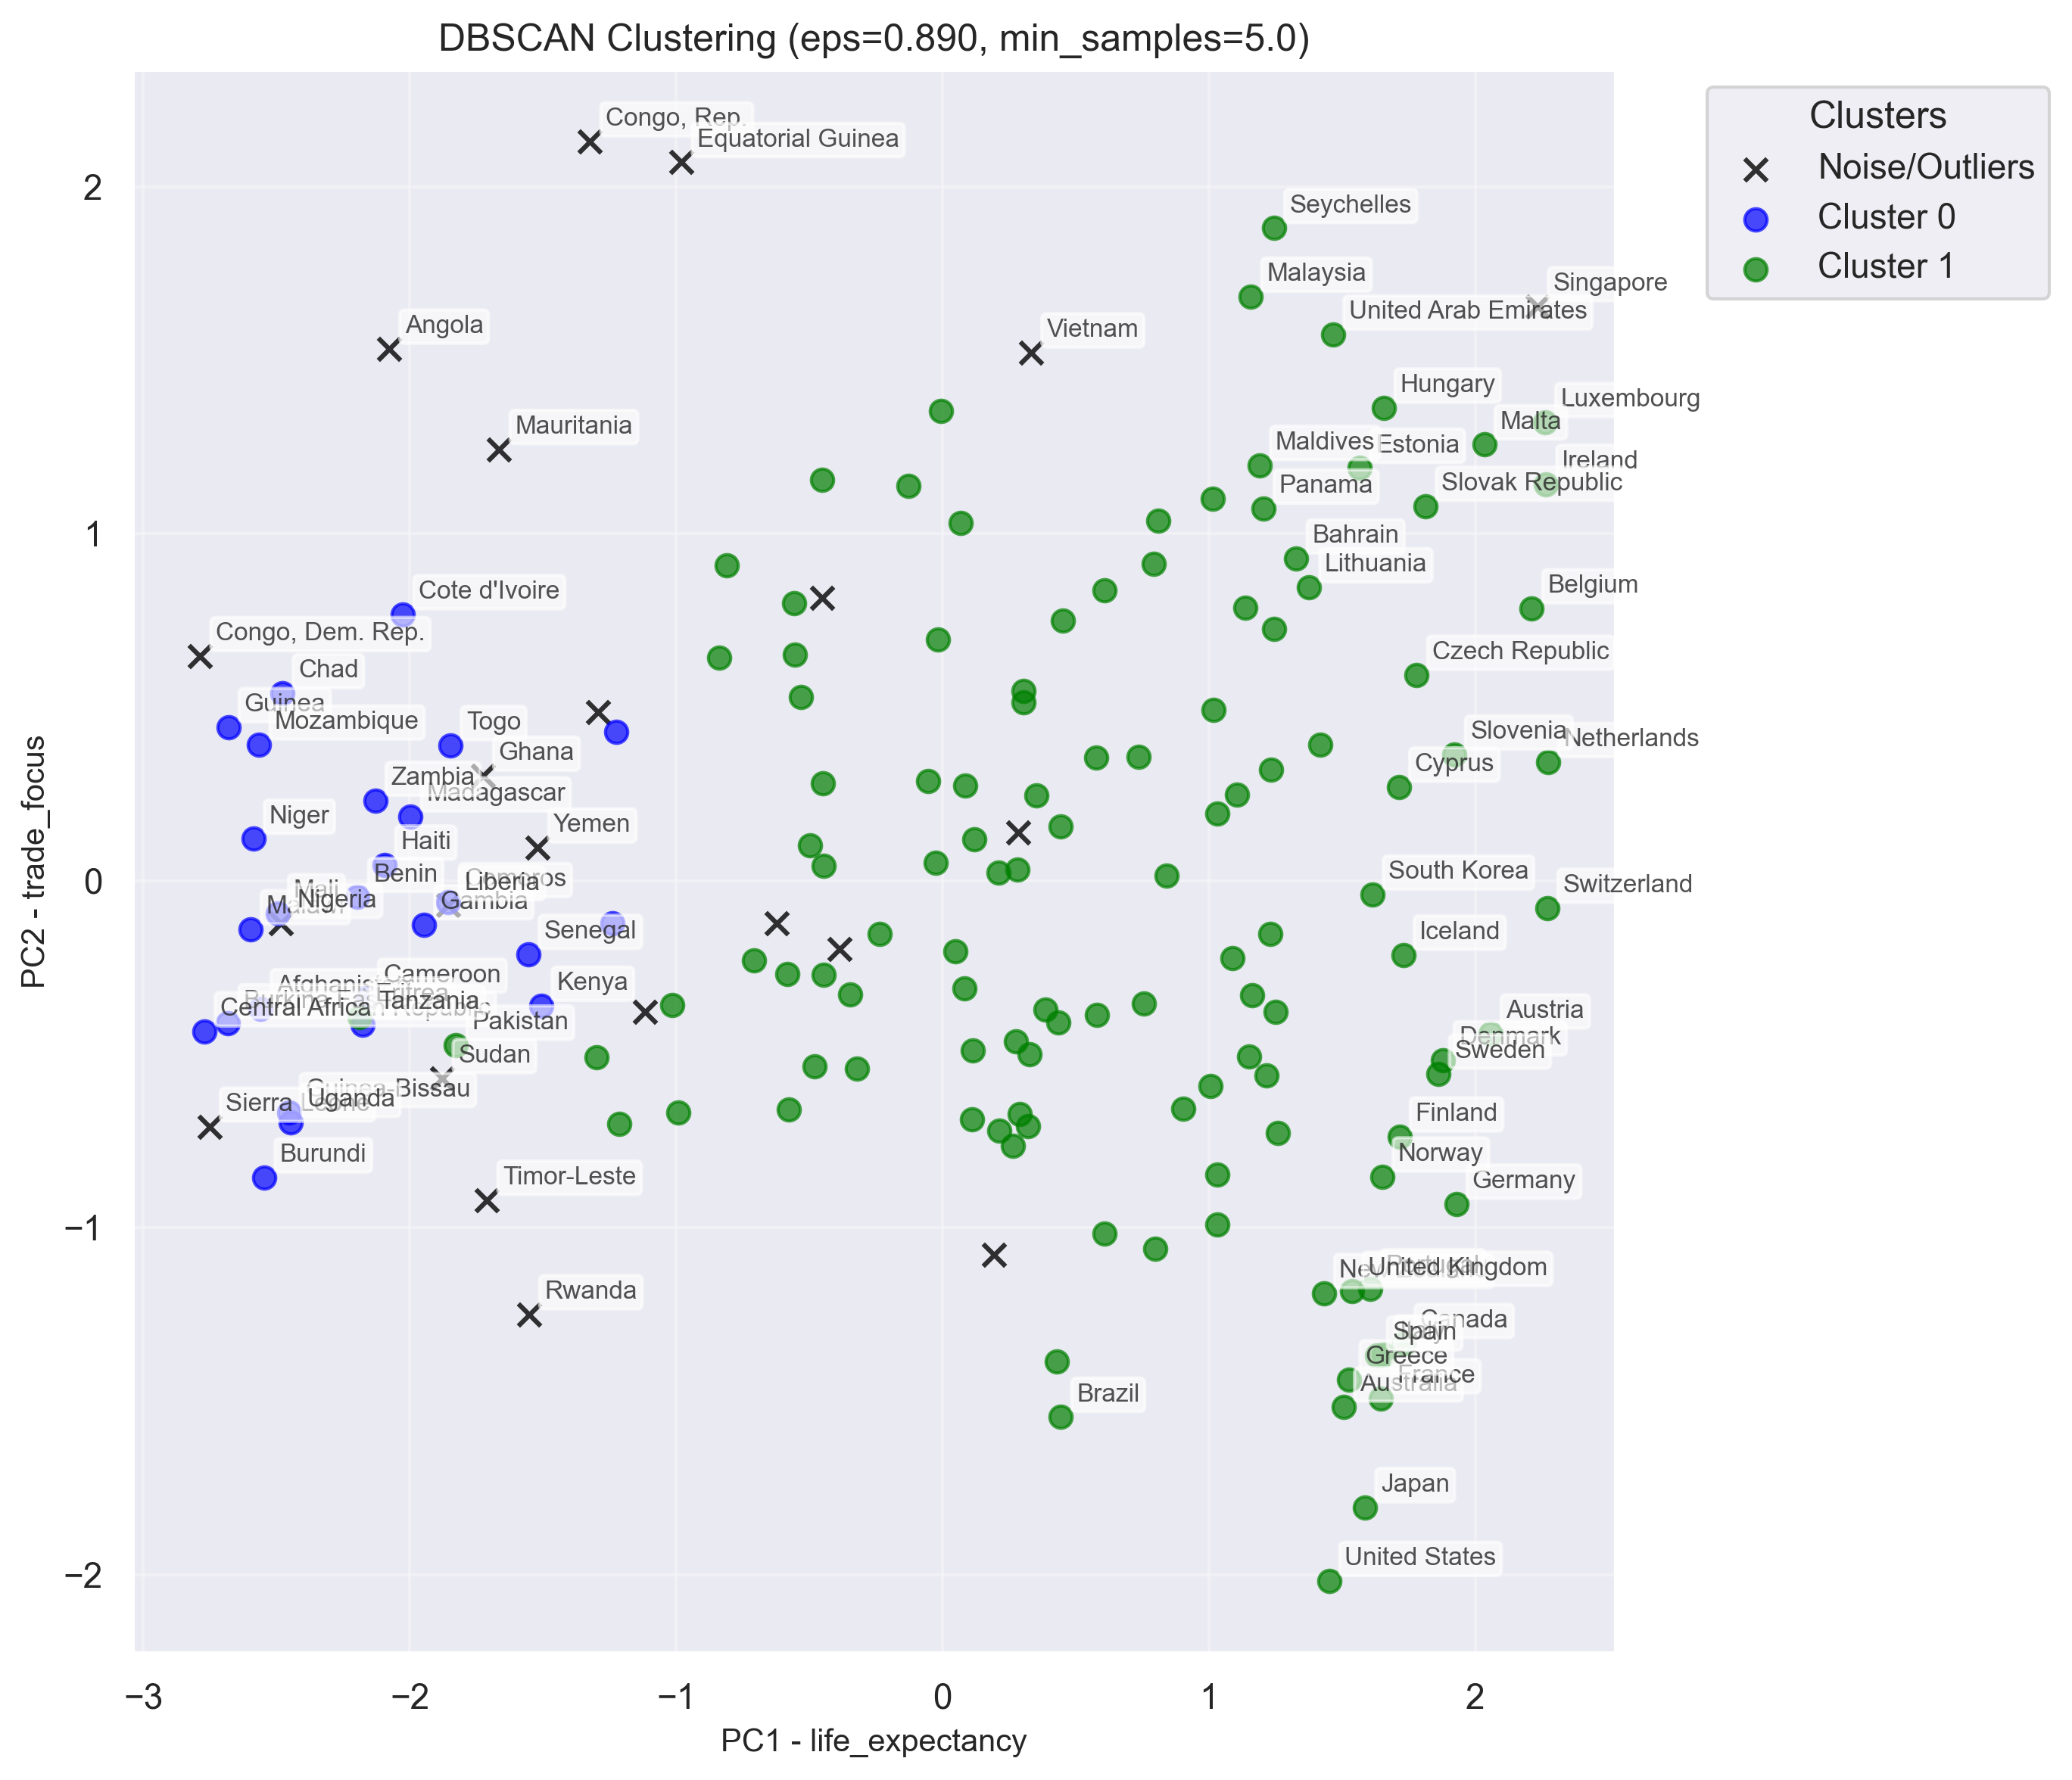
Both Hiearchical Clustering And DBSCAN Suggested Optimal k = 2, further work deferred to next steps

Slide 13
Conclusions
k-Means cluster solution with 5 clusters is more informative than with k=2 and is intuitively understandable.
"Least Developed Countries” is a good target for the CEO of HELP Organisation (Kaggle Objective
Combination of log-scaling, Winsorization and RobustScaler proved an effective way to deal with the outliers
Spending time on understanding the principal components before clustering was highly worthwhile.
Visualising the clusters using PCA bi-plots (with vectors and hulls) is a powerful way to understand the data.
Naming Clusters was hard and needed detailed analysis
More time needed on DBSCAN and Hierarchical Clustering to understand strengths & weaknesses

Slide 14
LEARNING
Handling outliers with differing scaling techniques and Winsorization.
PCA understanding and interpretation (with loading tables and charts to describe the principal components)
K-Means scoring to find optimal number of clusters using a basket of scoring metrics
Visualisation of clusters using PCA bi-plots (with feature vectors and hulls).
Time spent on understanding and interpretation should outweigh time spent on code generation.
I am not yet comfortable with the lack of easily available checks (predict, RMSE scoring, statistical significance,...) for unsupervised learning

